Slide 1
3.5 Combinatorial Circuits
35b
We have seen how to build a half-adder from gates.
Then we saw how to build a full adder from two half adders, and a ripple-carry adder from a series of full adders.
In this section we will see how to build two key control circuits, the decoder and the multiplexer.
We will also see how to build a binary shifter, which shifts a binary number left or right one bit.
Finally, we will put these pieces together to build a small ALU, or arithmetic-logic unit.

Slide 2
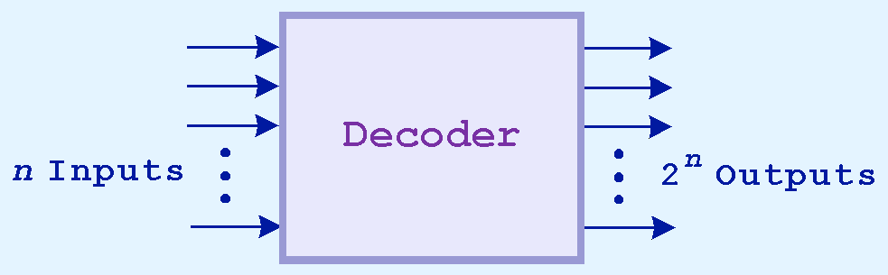
3.5 Decoders
36
Decoders are another important type of combinational circuit.
Among other things, they are useful in selecting a memory location according a binary value placed on the address lines of a memory bus.
Address decoders with n inputs can select any of 2^{n} locations.
This is a block diagram for a decoder.

Slide 3
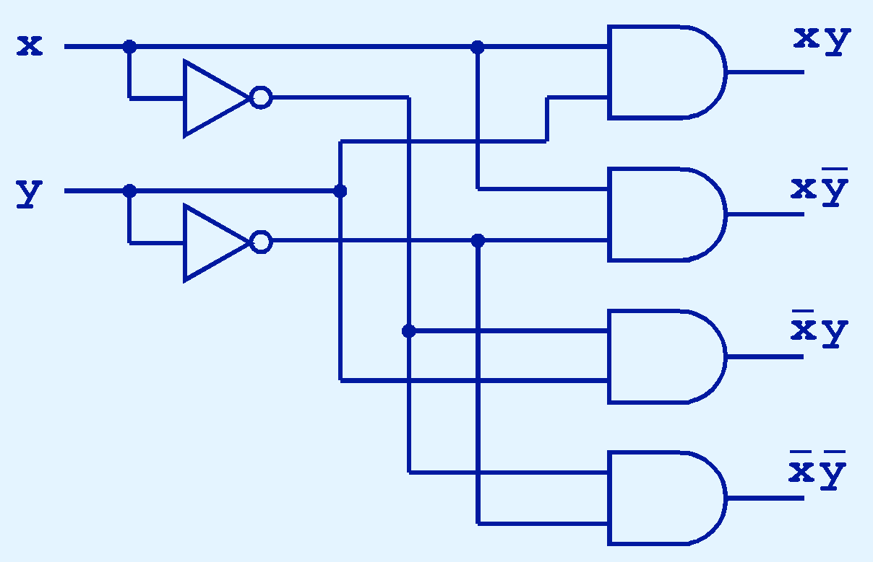
3.5 Decoders
37
This diagram shows the internals of a 2-to-4 decoder.
Remember that each output function is calculated separately.
Because of the nature of these outputs, only one of them can be true at any given time.

Slide 4
3.5 Decoders
37a
For example, the xy output is only true if x is true and y is true.
Each AND-gate has exactly two inputs.

Slide 5
3.5 Decoders
37b
A decoder is used to convert a binary number (B’xy’) to a value (0th, 1st, 2nd, 3rd output is true, counting from the bottom of the diagram.
Given an address, a decoder can be used to access the memory cell at that address.

Slide 6
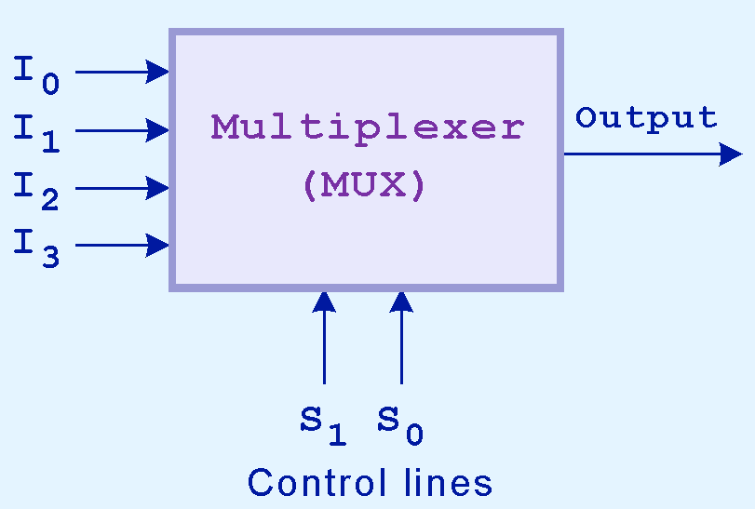
3.5 Multiplexers
38
A multiplexer, abbreviated mux, is the opposite of a decoder.
It selects a single output from several inputs.
The particular input chosen for output is determined by the value of the multiplexer’s control lines.
To be able to select among n inputs, log₂n control lines are needed.
This is a block diagram for a multiplexer.

Slide 7
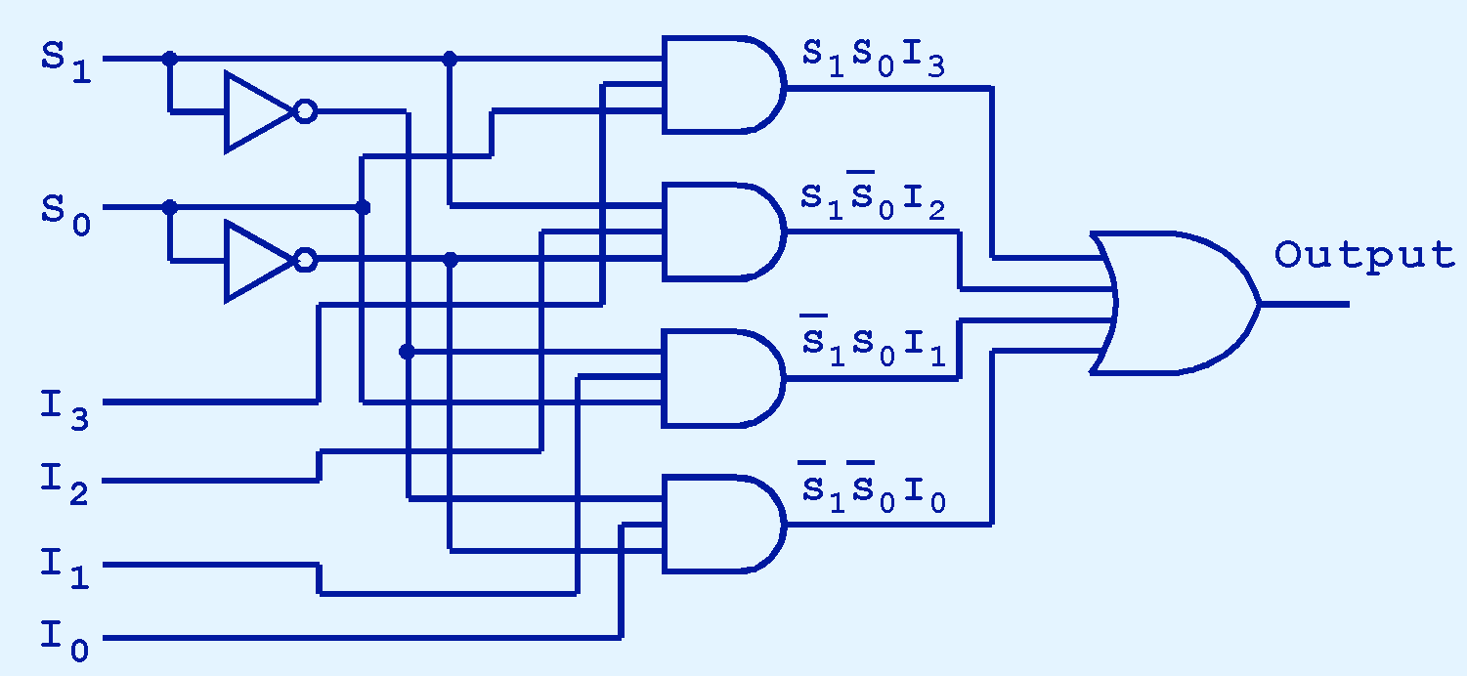
3.5 Multiplexers
39
This diagram shows the internals of a 4-to-1 multiplexer.
Note that only one of the AND-gates can be true at any given time.

Slide 8
3.5 Multiplexers
39a
Each input I_{n} is only connected to one of the AND-gates. That AND-gate is only true for a specific pair of values of S₀ and S₁. For example, the top one is true when S₁S₀ = 0b11.

Slide 9
3.5 Multiplexers
39b
Input I_{n} is connected to the AND-gate where the binary value S₁S₀ = n. From top to bottom, the AND-gates are connected to inputs # 3, 2, 1 and 0.

Slide 10
3.5 Multiplexers
39c
Each control input, S₀ and S₁, is provided in its original and negated form to make it easy to build the four AND-gates.

Slide 11
3.5 Multiplexers
39d
Since only one of the AND-gates is true at any one time, we can OR together their values to get the value of the input (I₀, I₁, I₂, or I₃) selected by the two S lines.

Slide 12
3.5 Multiplexers
39e
A multiplexer can be used to send data from a given memory cell to a register. The memory address is given in S₁S₀.

Slide 13
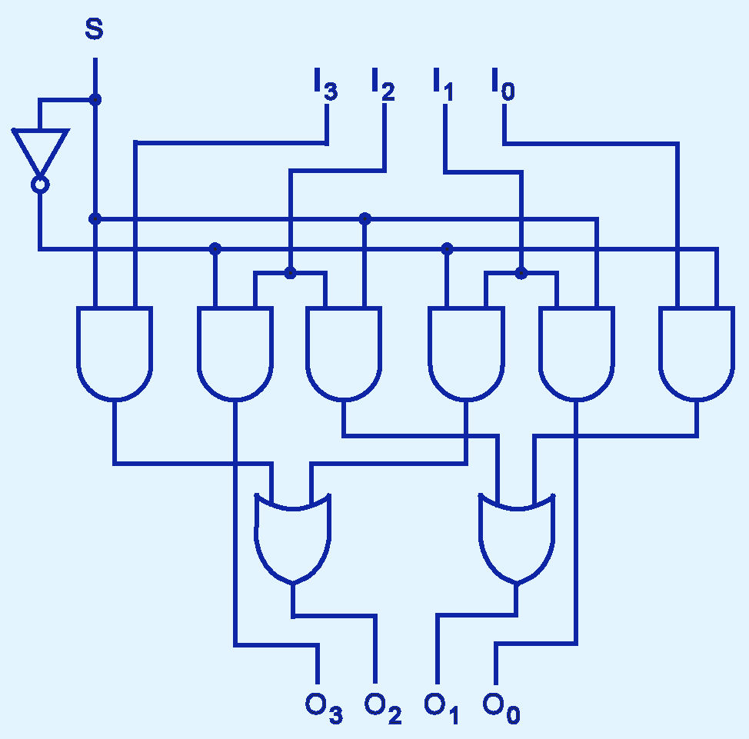
3.5 Shifter
40
This shifter moves the bits of a nibble one position to the left or right.
If S = 1, we have a right shift. Output O₂ comes from input I₃.

Slide 14
3.5 Shifter
40a
If S = 0, we have a left shift. Output O₂ comes from input I₁.
Check out the OR-gates to ensure only one input can be true at a time.

Slide 15
3.5 Shifter
40b
Make sure you know how each of the four outputs is calculated for S=0 and S=1.

Slide 16
3.5 A Two-Bit ALU
40c
Remember that the ALU, or arithmetic-logic unit, is a core part of the CPU that handles arithmetic and logic.
We can use the combinational circuits we have learned to build an ALU. Our sample ALU (see last slide for picture) will handle four operations - AND, OR, NOT and addition - for two-bit numbers.
The inputs are A₁A₀ and B₁B₀. The output is C₁C₀.
The control lines I₀I₁ determine which operation will be done.
  00 = addition 01 = NOT
  10 = OR 11 = AND

Slide 17
3.5 A Two-Bit ALU
40d
For AND and OR, make sure you can see how the righthand bits of A and B are channeled into the righthand bit of C, and similarly for the lefthand bit.
For NOT, make sure you can see how each bit of A is inverted before passing it into C.
For A + B, make sure you can see how the rightmost bits go into the half-adder and the leftmost bits go into the full adder.
  Also verify that the carry from the half-adder to the full adder, and the carry from the full adder to the overflow, are correctly passed along.

Slide 18
3.5 A Two-Bit ALU
40e
Then check the control logic:
Make sure you can see how each of the four possible outputs of the decoder are AND’ed to the gates for the corresponding operation so that the result from only one operation is passed to the output.
  Note that this is an additional use of a decoder. Earlier we saw how a decoder can be used to select one memory cell from a set of 2^{n} memory cells. Here we are selecting one operation from a set of 2^{n} operations.
Finally, make sure you can see how the outputs from the different operations are OR’ed together to create a single output.

Slide 19
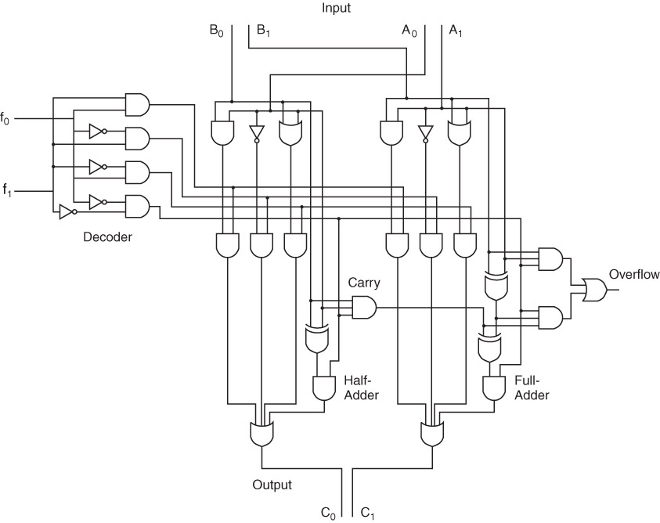
3.5 A Two-Bit ALU
40f
I₀
I₁

